Slide 1

Structural Integrity Renovation Project
GENG5505 Project Management
Owen Santoso (22466085)

Slide 2
Project Lifecycle → Stage 2: Planning
Conceptualisation
Planning
Finalisation
Execution

Slide 3




Main Sections Contributed
Section B - 2.3.2 Scope Management
01
Section B - 2.3.5 Cost Management
02
Section B - 2.3.3 Stakeholder Management
03
Section A - 3.1.1 Stakeholder Priority Analysis
04

Slide 4



Section B - 2.3.2 Scope Management
“The scope defines all the work that needs to be performed in order to complete the project successfully.” (Hartley 2018)
Project manager “doesn’t believe in scope creep”
Unknown factors for each house
Team lacked effective scope management plan

Slide 5



Section B - 2.3.5 Cost Management
Contracted work under a lump-sum contract
Fixed price for a scope of work
No cost overruns
Contrasts with contracts paid per hour
Delays can lead to significant cost overruns
Contractor incentivised to complete the job early
May rush job, leading to poor quality work

Slide 6

Section B - 2.3.3 Stakeholder Management
Key stakeholders identified:
Problems with tenants objecting to renovations
Tenants
Contractor
Operational leaders
Notice to tenants was too short, only a few weeks
“Identifying stakeholders is not enough, their needs and particular interests must be addressed” (Hartley 2018)

Slide 7
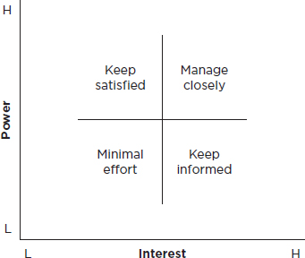
Section A - 3.1.1 Stakeholder Priority Analysis
Lack of understanding in importance of stakeholders
Identified key stakeholders, but did not prioritise them
Stakeholder power interest matrix is recommended

